Slide 1

New View Alliance
To meet the challenges of a complex and rapidly changing service environment, Gateway-Longview, Inc., and New Directions Youth & Family Services, Inc, have joined in a strategic affiliation with the creation of a new parent company, New View Alliance, Inc., which is now among the largest non-profits in Western New York.
As the parent company, New View Alliance provides oversight, strategic planning and advocacy for both affiliated agencies, each of which will continue to operate as individual service entities but with a shared strategic vision. The affiliation also allows for the parent company to provide shared administrative support for finance, human resources, information technology, corporate integrity, and DEIJ (Diversion, Equity, Inclusion and Justice)
Leading social change through advocacy, collaboration and service to children and families
Notes:
Somebody may have already reviewed what New View Alliance is with you, but…New View is the agency that provides administrative support to New Directions which is responsible for providing the direct services to youth and their families.
New View provides New Directions with services including Human Resources, Finance, Compliance, IT, and so on.

Slide 2
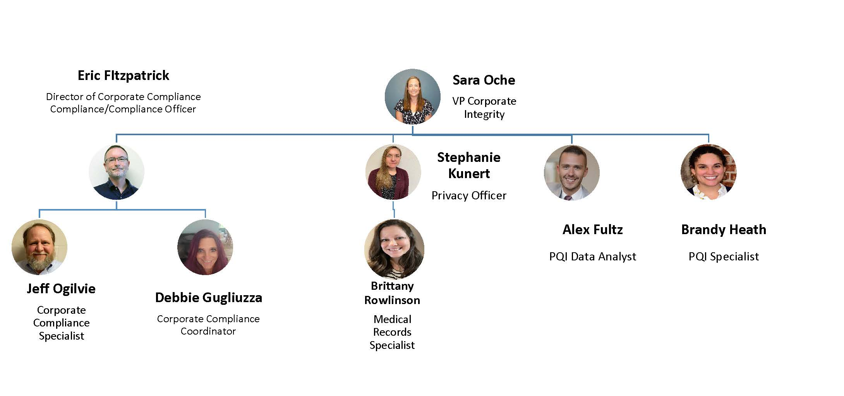
New View Alliance
Corporate Integrity Department
Notes:
Corporate Compliance falls within the Corporate Integrity Department, which also includes Privacy and Quality Improvement.
You will hear more about Privacy during orientation and Quality Improvement through Relias (which our Learning Management System).

Slide 3
Risks of Fraud Waste & Abuse (examples)
Examples:
  Prescribing more medications than necessary for treating a specific condition (Waste/Abuse)
  Unknowingly misusing codes on a claim (Abuse/Waste)
  Knowingly billing for services not provided (Fraud)
  Unknowingly billing for unnecessary medical services (Abuse/Waste)
  Knowingly altering claim forms or medical records to receive a higher payment (Fraud)
Programs/services with highest risks related to Medicaid:
  Article 31 clinic
  CFTSS services
  Health Homes services
  Article 29-I services
Notes:
Fraud, Waste, and Abuse can happen in many different way!
Fraud is intentional deception of government programs, such as Medicaid. Examples, might include billing for services not provided or falsifying treatment plans for our clients. Examples include a Care Manager documenting and billing for a home visit that they did not actually provide, or a CFTSS clinician forging a parent signature on a treatment plan.
Waste includes practices which create unnecessary costs to the Medicaid program. An example might include saying a client needs a higher level (and more expensive) service than they actually need, or more services than needed.
Abuse related to poor practices, such as providing ineffective services that do not truly help the client.
Doing things the way that we should:
Reduces Medicaid costs to all of us!
Protects our business reputation
Produces good audit results from government agencies (which helps minimize fines and penalties)
Protects you by expecting you to do the right thing

Slide 4
Reporting Potential Compliance Issues
Examples of Reportable Compliance Issues
Every employee is required, as a condition of employment, to report any practice that the employee, in good faith, believes violates, or may violate, agency Standards and Code of Conduct, agency Compliance Policies and Procedures, or any applicable rules, laws, or regulations
Billing for items or services not actually documented
Inappropriate gifts and entertainment from contractors and/or vendors
A real or perceived Conflict of Interest
Patient privacy issues (breach of information)
Notes:
The Standard of Conduct describes how to act ethically: provide good quality of care, be accurate with all documentation (including time sheet), avoiding Conflicts of Interest, etc.
Accurate documentation is critical! What is the Golden Rule of documentation??
Reporting problems is a key component of our compliance plan. As employees, we all have an obligation to report violations of the Standards of Conduct!
What is first step when you see someone doing something wrong?
What if they still do it?
What if you boss tells you to do something that is wrong?
The Whistleblower policy describes the process to report problems.
Nobody should harass you for filing a report!! What do you do if you believe you are being harassed because you reported someone? (Non-retaliation policy describes what to do in case you believe you are being harassed.)
Compliance is a resource, as well!! (Next slide!!)

Slide 5
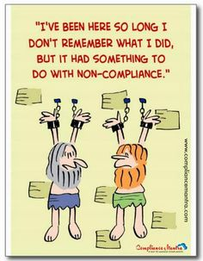
Here’s How You Make a Report
(The information below is also on the Standards of Conduct)
Email or phone Corporate Compliance Officer:
  Eric Fitzpatrick
  716-529-1240
  EFitzpatrick@newviewalliance.org
Talk with your Supervisor, Director, or COO/VP of your Department who will help you make the report.
Notes:
Corporate Compliance is a resource as well, if you are aware of things like ethical violations, fraud, retaliation, or harassment
I (Eric Fitzpatrick) am the Corporate Compliance Officer for all three agencies!
People sometime call and talk through situations. If serious enough, I might initiate an investigation. Other times, I might work with programs to correct problems…depend on the circumstances.

Slide 6
Whistleblower Hotline
  SECURE, ANONYMOUS, CONFIDENTIAL
    Website: www.lighthouse-services.com/newviewalliance
    Toll-Free Telephone:
      English speaking USA and Canada: (877) 472-2110
      Spanish speaking USA and Canada: (800) 216-1288
    E-mail: reports@lighthouse-services.com (must include company name with report)
    Fax: (215) 689-3885 (must include company name with report)
    Letter: Lighthouse Services, Inc.
    1710 Walton Road, Suite 204, Blue Bell, PA 19422
Notes:
Despite having a non-harassment policy, we know people still fear making reports. If you feel like you want to make an anonymous report for any reason (including fraud), PLEASE use our Hotline!
Explain Hotline:
External company keeps you anonymous
Contact the Hotline any way listed on this slide
They will communicate with you to fully understand your concern
They report concerns to me
We determine how to address or to investigate
Summary of findings and corrective actions is reported to the Hotline
Hotline informs you of this summary
We do this to be transparent with you…we want you to know what we have done to correct the problem you reported!

Slide 7
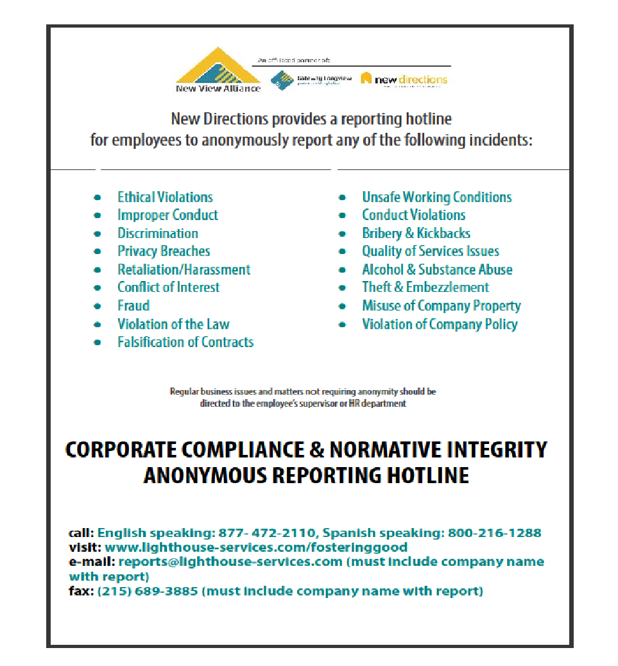
Notes:
This is our Hotline poster. This should be posted at your sites. If it is not, please let your supervisor or me know.
This includes a list of things you can report, but is not limited to this!

Slide 8
Questions??
The New View Alliance Corporate Compliance Plan and Corporate Compliance Policies are located on the New View Alliance web page: https://www.newviewalliance.org/policies
Email or phone the Corporate Compliance Officer: Eric Fitzpatrick
  716-529-1240
  EFitzpatrick@newviewalliance.org

